Slide 1
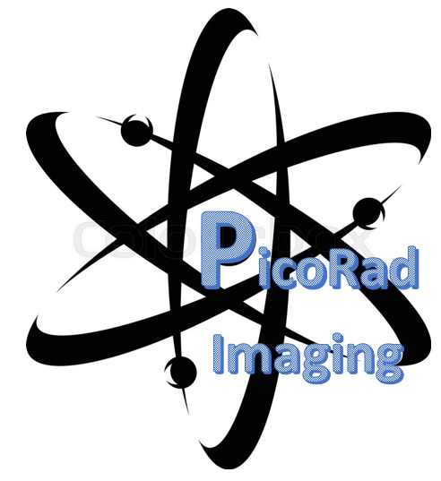

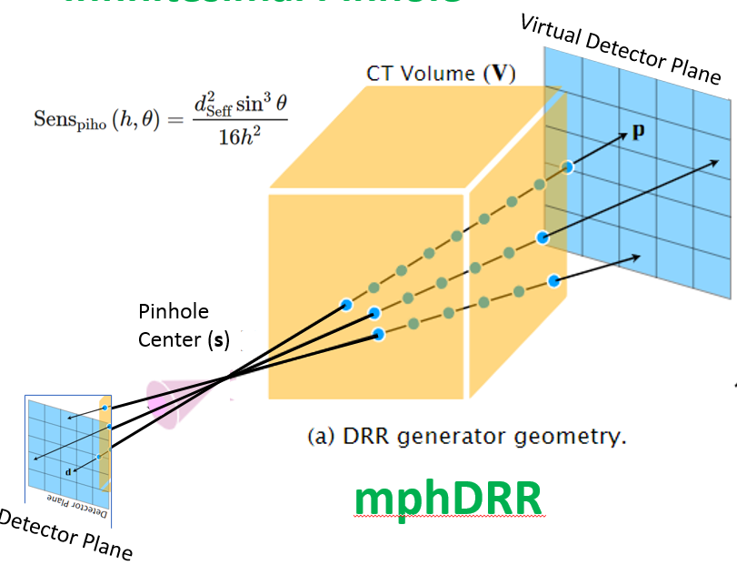
mphDRR Design and Literature Review
Bill Worstell
PicoRad->MGH
12/22/2023

Slide 2
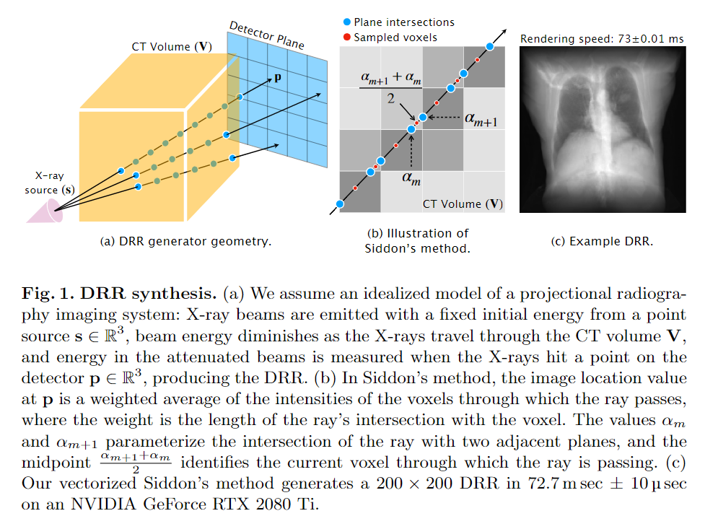
Gopalakrishnan, V. and Golland, P., 2022, September. Fast auto-differentiable digitally reconstructed radiographs for solving inverse problems in intraoperative imaging. In Workshop on Clinical Image-Based Procedures (pp. 1-11). Cham: Springer Nature Switzerland.
mphSPECT differs from
X-ray forward projection, requiring multiplication by reciprocal squared distance from pinhole to source voxel

Slide 3
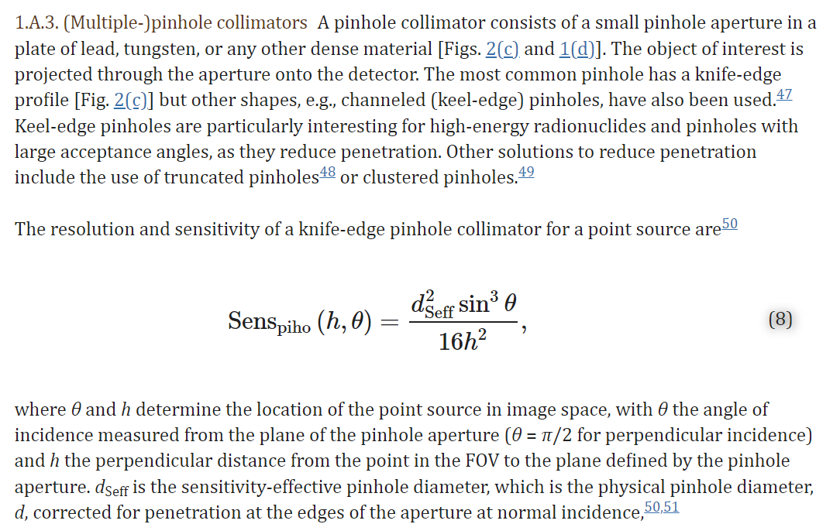
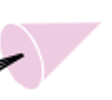
Virtual Detector Mapping for Infinitesimal Pinhole
Xray DRR
Virtual Detector Plane
Pinhole
Center (s)
Gopalakrishnan, V. and Golland, P., 2022, September. Fast auto-differentiable digitally reconstructed radiographs for solving inverse problems in intraoperative imaging. In Workshop on Clinical Image-Based Procedures (pp. 1-11). Cham: Springer Nature Switzerland.
mphDRR
Detector Plane

Slide 4
Van Audenhaege, K., Van Holen, R., Vandenberghe, S., Vanhove, C., Metzler, S.D. and Moore, S.C., 2015. Review of SPECT collimator selection, optimization, and fabrication for clinical and preclinical imaging. Medical physics, 42(8), pp.4796-4813.
mphDRR differs from
X-ray forward projection, requiring multiplication by reciprocal squared distance from pinhole to source voxel

Slide 5
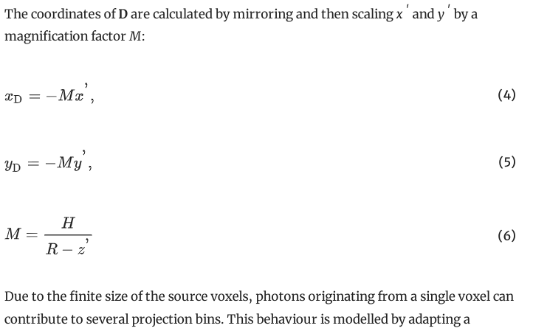
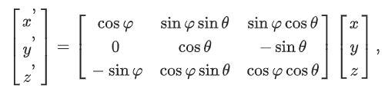
Peterson, M., Gustafsson, J. and Ljungberg, M., 2017. Monte Carlo-based quantitative pinhole SPECT reconstruction using a ray-tracing back-projector. EJNMMI physics, 4, pp.1-21.
This is for a rotating mphSPECT system, but we use a similar mapping and make the same approximations
The line from the source volume origin through the pinhole centre is referred to as the pinhole axis, and the direction of the pinhole axis is specified by a polar angle θ and an azimuthal angle φ. The coordinates of D are calculated from those of P using the detector-to-pinhole distance H and origin-to-pinhole distance R.
model includes several approximations. These are that (a) no attenuation or scatter occurs in the object, (b) the pinhole aperture opening is infinitely small without penetration effects (i.e. perfect collimation), and (c) the efficiency is independent of the incident angle.

Slide 6
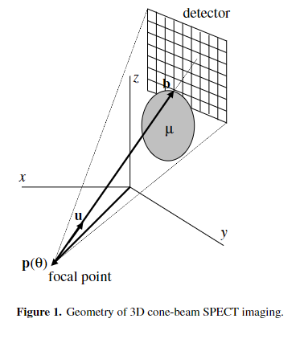
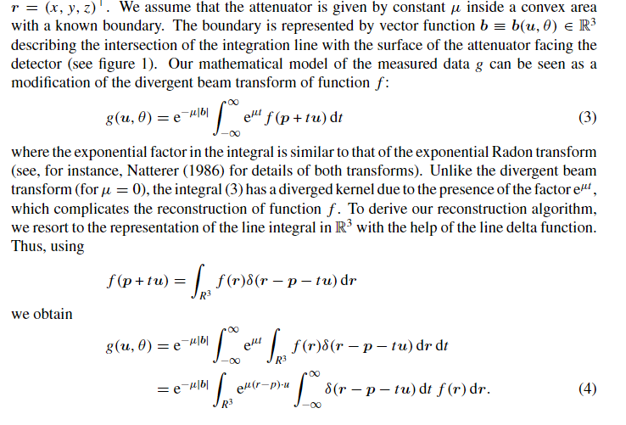
Bronnikov, A.V., 2000. A filtering approach to image reconstruction in 3D SPECT. Physics in Medicine & Biology, 45(9), p.2639.
We will ignore attenuation, planning to use PyTomography method of co-registering with dual-energy CT and modeling attenuation at SPECT energies

Slide 7
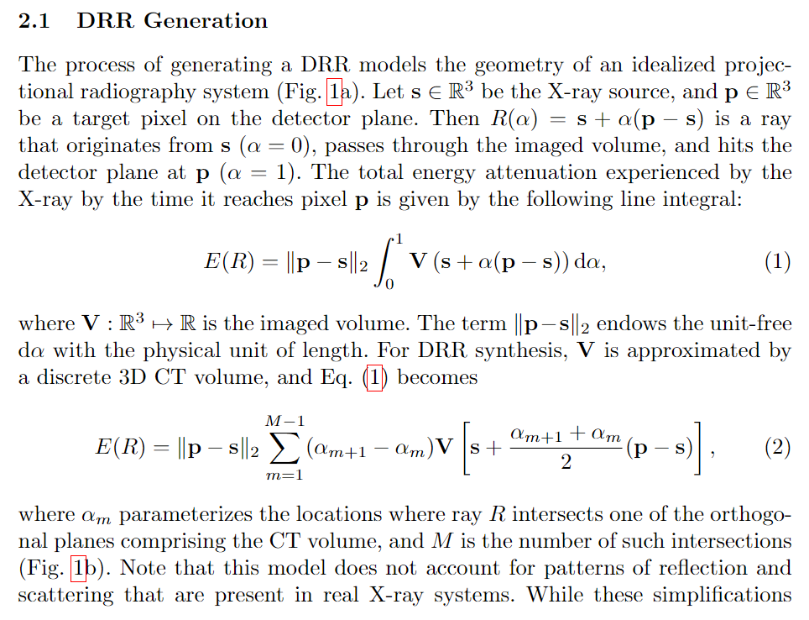
Gopalakrishnan, V. and Golland, P., 2022, September. Fast auto-differentiable digitally reconstructed radiographs for solving inverse problems in intraoperative imaging. In Workshop on Clinical Image-Based Procedures (pp. 1-11). Cham: Springer Nature Switzerland.
mphDRR differs from
X-ray forward projection in requiring multiplication of voxel source intensity by reciprocal of squared pinhole source to voxel distance

Slide 8
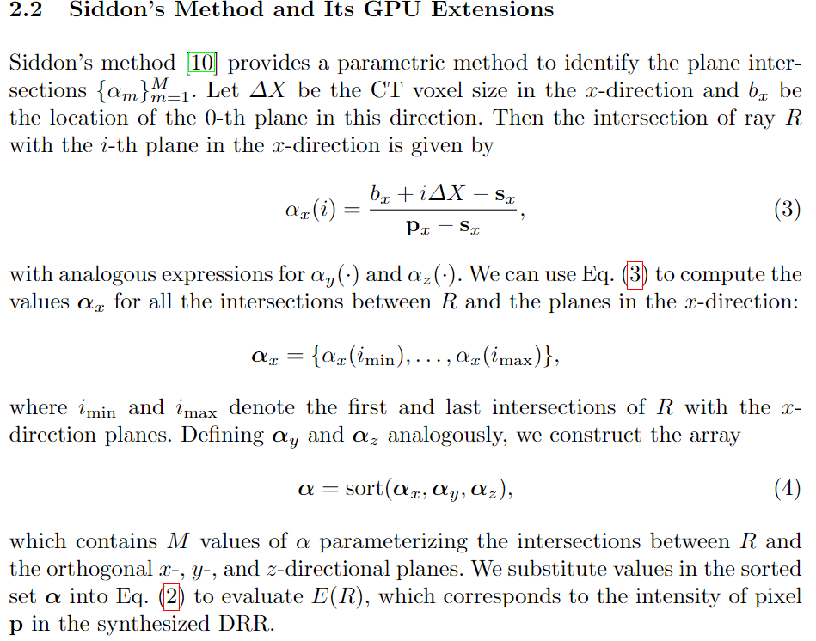
Gopalakrishnan, V. and Golland, P., 2022, September. Fast auto-differentiable digitally reconstructed radiographs for solving inverse problems in intraoperative imaging. In Workshop on Clinical Image-Based Procedures (pp. 1-11). Cham: Springer Nature Switzerland.
mphDRR does NOT differ from X-ray forward projection in the generation of Siddon coefficients, just in their application in a modified Eq. (2)

Slide 9
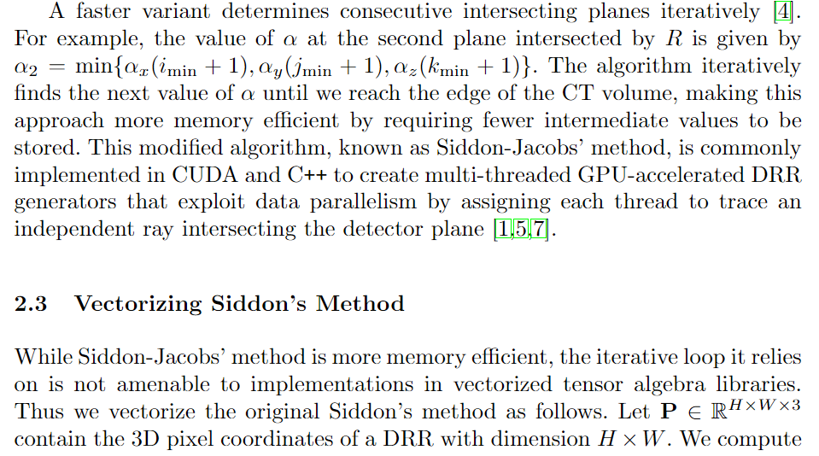
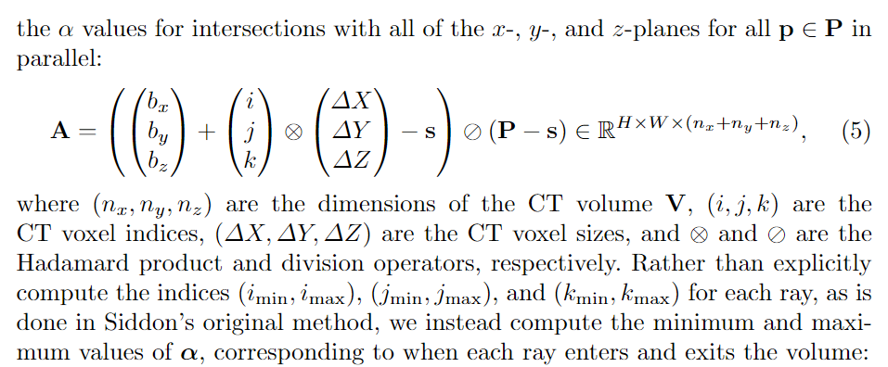
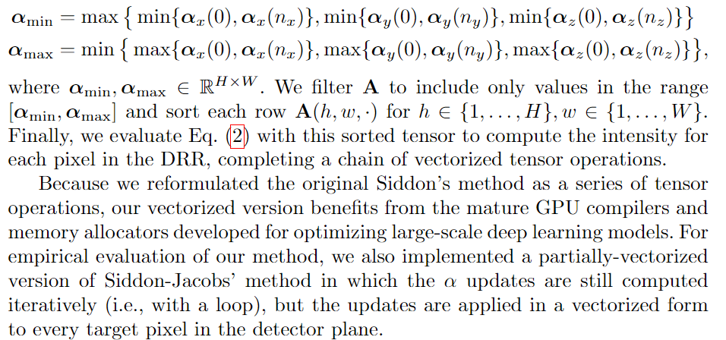
Gopalakrishnan, V. and Golland, P., 2022, September. Fast auto-differentiable digitally reconstructed radiographs for solving inverse problems in intraoperative imaging. In Workshop on Clinical Image-Based Procedures (pp. 1-11). Cham: Springer Nature Switzerland.
mphDRR does NOT differ from X-ray forward projection in the generation of Vectorized Siddon coefficients, just in their application in a modified Eq. (2)

Slide 10
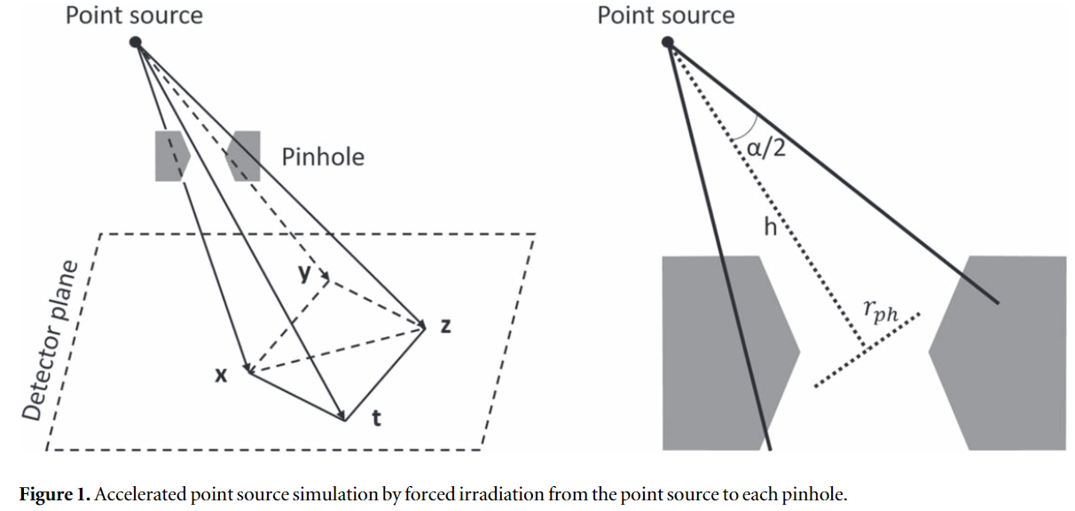
Nguyen, M.P., Goorden, M.C., Ramakers, R.M. and Beekman, F.J., 2021. Efficient Monte-Carlo based system modelling for image reconstruction in preclinical pinhole SPECT. Physics in Medicine & Biology, 66(12), p.125013.
2.3.2. Accelerated point source simulationThis step is the key that allows for the accurate generation of PSFs for the radionuclide of interest based on MCS without additional measurements. In this simulation, an infinitely small point source was defined in GATE, with the same set of point source positions as in the calibration measurement being used. The point source was assumed to be in water. A simple acceleration technique was applied for the point source simulation by directing the photon emission from the point source to the pinholes in narrow beams instead of the default emission at all angles. This is a kind of forced detection—one of the variance reduction techniques in MCS. There exist several implementations of forced detection for pinhole SPECT (Gieles et al 2002, Beenhouwer and Staelens 2010). In our method, only the emission angle from the decay location at the point source is adjusted, and no alteration is applied at individual photon interaction points as in the other methods, meaning it is simple to implement in GATE at the macro level just by setting the span of the polar angle and the azimuthal angle of the emission distribution. Note that this acceleration technique was used for a point source, but it was not suitable for large sources and hence not used for the studied scans in section 2.4.In our acceleration technique, the photon beams were adapted for each point source and pinhole combination.
We have been using a similar method to speed our GATE simulations.
We can learn from GATE system models.

Slide 11
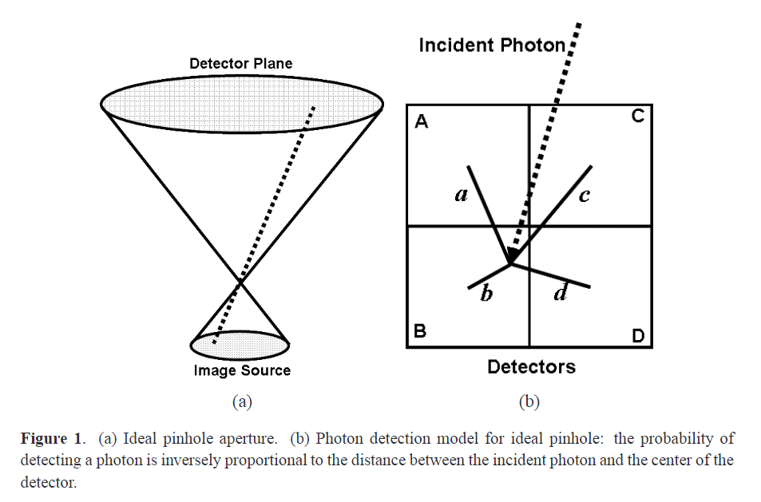
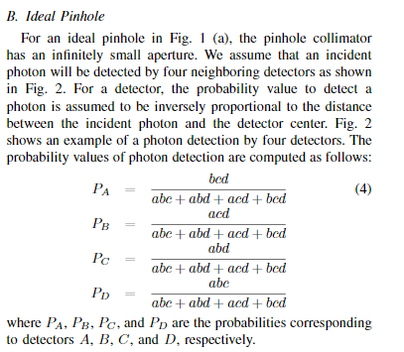
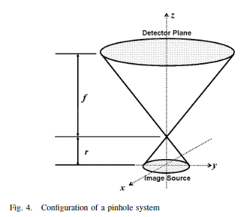
Huang, P.C., Hsu, C.H., Hsiao, I.T. and Lin, K.M., 2009. An accurate and efficient system model of iterative image reconstruction in high-resolution pinhole SPECT for small animal research. Journal of Instrumentation, 4(06), p.P06007.
Simple methods exist for modeling PSF effects from detector coordinate discretization and finite-size pinholes

Slide 12
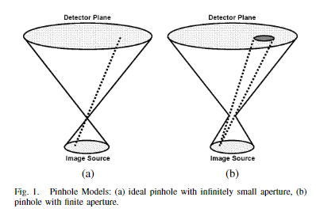
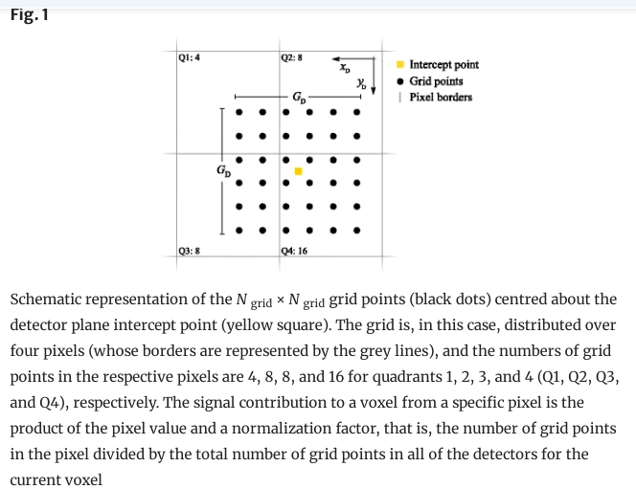
Huang, P.C. and Hsu, C.H., 2004, October. Finite aperture modeling in small animal pinhole SPECT imaging. In IEEE Symposium Conference Record Nuclear Science 2004. (Vol. 6, pp. 3454-3457). IEEE.
PSF modeling for more realistic pinholes generally casts multiple rays, which PyTorch mphDRR is well-suited for
consider an image voxel, say image voxel j. To compute the probability value of Pij , we repeat the following step for each grid in detector i. A line is drawn between thecenter of an image voxel and the center of that grid. If the line can pass through the pinhole, the corresponding grid is a valid candidate which can contribute the photon detection at detectori. Therefore, the probability Pij of detector i to detect photons from image voxel j should be proportional to the number of valid grids satisfying the following criterion.

Slide 13
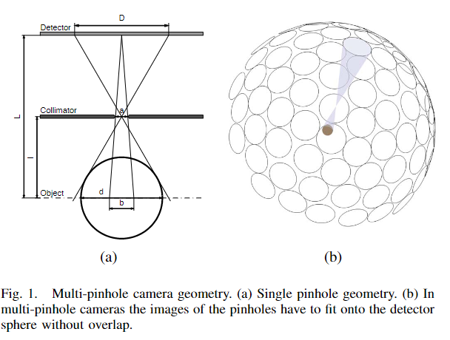
Nillius, P. and Danielsson, M., 2008, October. Theoretical bounds and optimal configurations for multi-pinhole SPECT. In 2008 IEEE Nuclear Science Symposium Conference Record (pp. 5020-5022). IEEE.
This work describes multi-pinhole SPECT system design issues more generally

